Slide 1


Bank Customer Churn
Case Study

Slide 2


MEET Our team
Supervisor: ENG. Mahmoud elsayed
Mohamed Elassyouty
Mohamed Fekry
Mohamed Meselhy
Hassan Waked
Mustafa Mahmoud

Slide 3

Agenda
Introduction
Problem Statement & Objectives
Data Sources & Description
Preprocessing & Feature Engineering
Exploratory Data Analysis (EDA)
Power BI
Machine Learning Model
Deployment

Slide 4
Introduction

Slide 5
Dataset overview
Dataset Purpose:
This dataset contains information about bank customers and their account activities. It is primarily used for customer churn analysis — predicting whether a customer will leave the bank.
Number of Attributes:
14 columns describing customer demographics, account status, and banking activity.
Key Features:
Customer Information: Customer ID, Surname, Age, Gender, Geography.
Banking Behavior: Credit Score, Tenure, Balance, Number of Products, Has Credit Card, Is Active Member.
Financial Data: Estimated Salary.
Target Variable: Exited (1 = Customer left, 0 = Customer stayed).

Slide 6
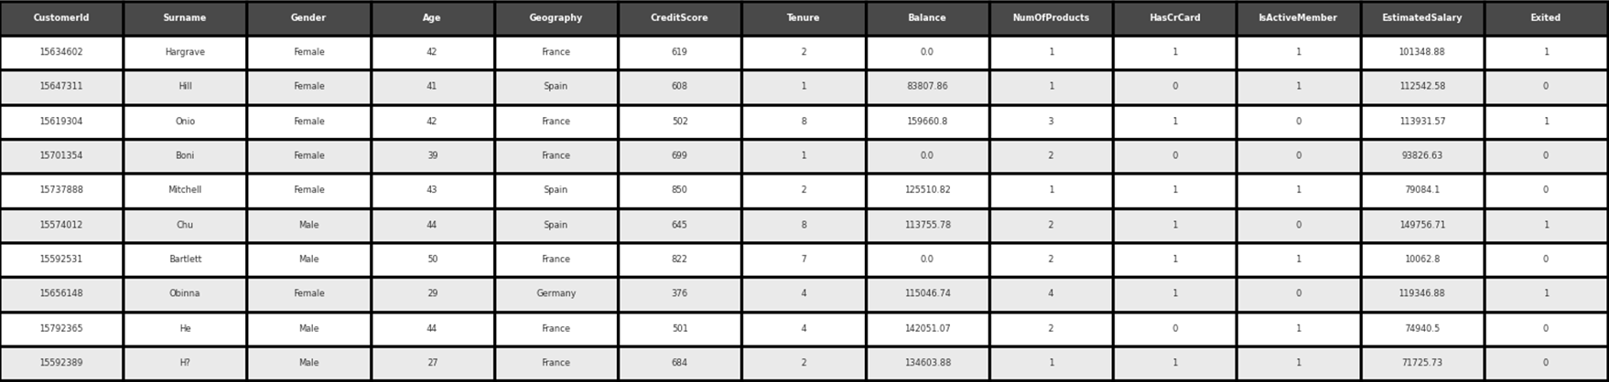
Customer churn demographic table

Slide 7
Problem statement
Objectives

Slide 8
Problem statement
Customer churn poses a significant threat to banks by reducing revenues and increasing customer acquisition costs. Despite having access to extensive demographic, financial, and behavioral data, identifying customers at risk of leaving remains a challenge.
This project addresses the need to analyze customer data to accurately predict churn and develop effective retention strategies that enhance customer loyalty and improve overall bank performance.

Slide 9
Objectives
ANALYZE
DEVELOP
IDENTIFY
PROVIDE

Slide 10
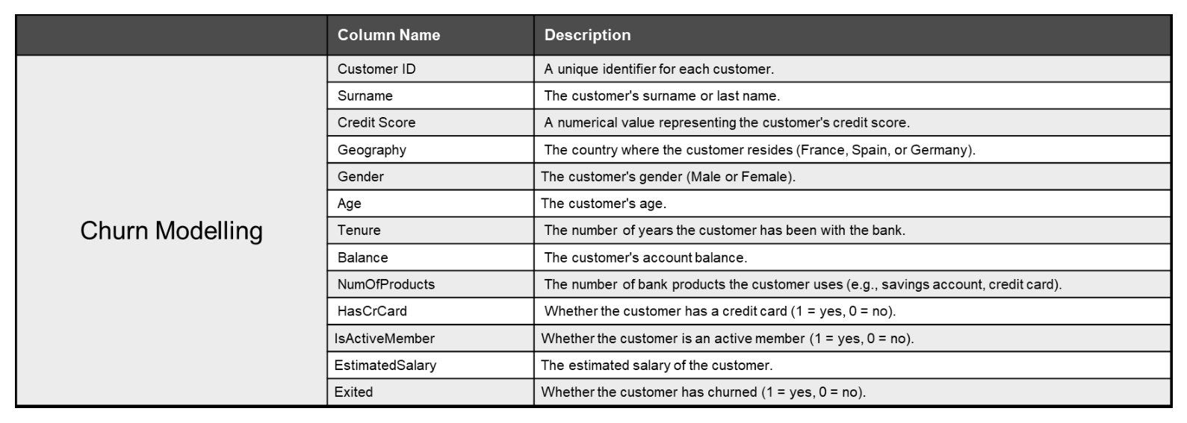
Metadata

Slide 11
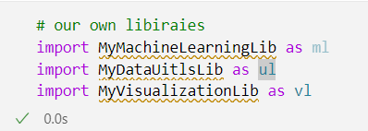
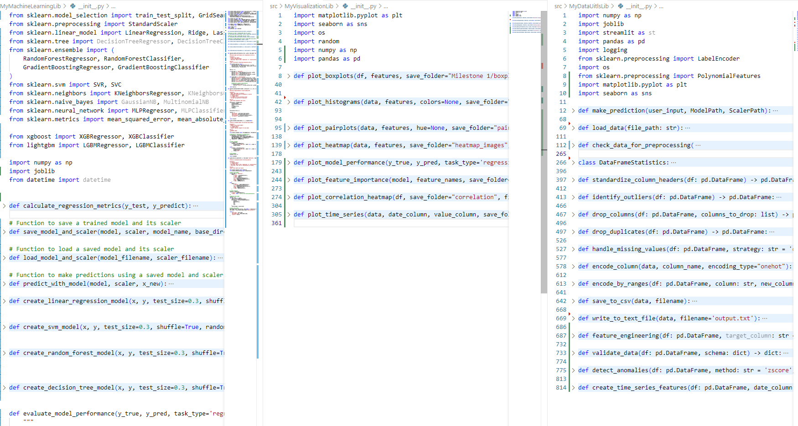

Slide 12
Data Collection
Description

Slide 13
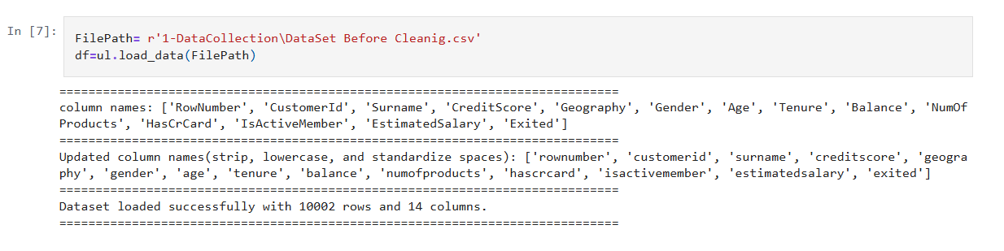
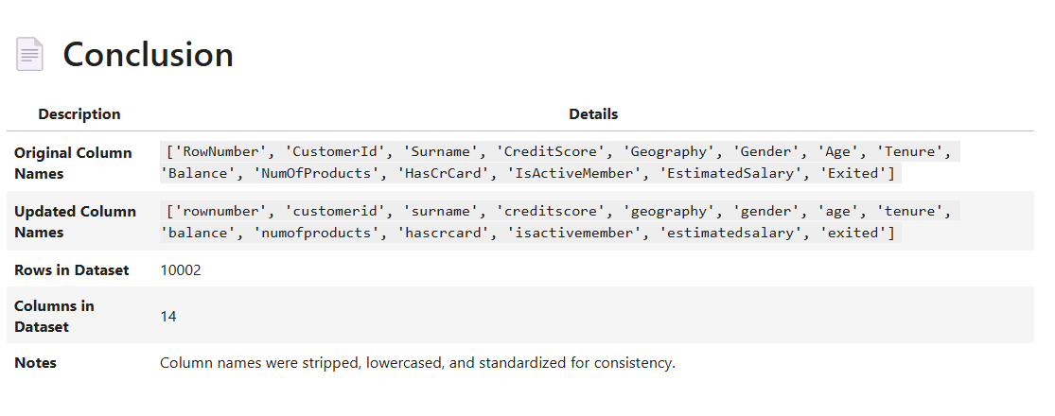
Data Collection
Load the dataset (CSV, SQL, API, etc.)
Understand the source and quality of the data

Slide 14
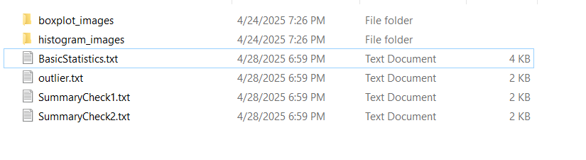
Data Understanding
View dataset structure (rows, columns)
Check data types and sample values
Identify target and feature variables
Understand the business/domain context

Slide 15
Features
Feature | Unique Count | Unique Percentage
gender | 2 | 0.02%
hascrcard | 2 | 0.02%
isactivemember | 2 | 0.02%
exited | 2 | 0.02%
geography | 3 | 0.03%
numofproducts | 4 | 0.04%
tenure | 11 | 0.11%
age | 73 | 0.73%
creditscore | 460 | 4.60%
surname | 2,932 | 29.31%
balance | 6,382 | 63.81%
estimatedsalary | 9,999 | 99.97%
rownumber | 10,000 | 99.98%
customerid | 10,000 | 99.98%
Rows | 10,002
Columns | 14
Dataset Shape
Unique Values per Feature

Slide 16
Features
Feature | Missing Count | Missing Percentage
rownumber | 0 | 0.00%
customerid | 0 | 0.00%
surname | 0 | 0.00%
creditscore | 0 | 0.00%
geography | 1 | 0.01%
gender | 0 | 0.00%
age | 1 | 0.01%
tenure | 0 | 0.00%
balance | 0 | 0.00%
numofproducts | 0 | 0.00%
hascrcard | 1 | 0.01%
isactivemember | 1 | 0.01%
estimatedsalary | 0 | 0.00%
exited | 0 | 0.00%
Metric | Value
Duplicate Count | 2
Duplicate Percentage | 0.02%
Dataset Shape
Unique Values per Feature

Slide 17
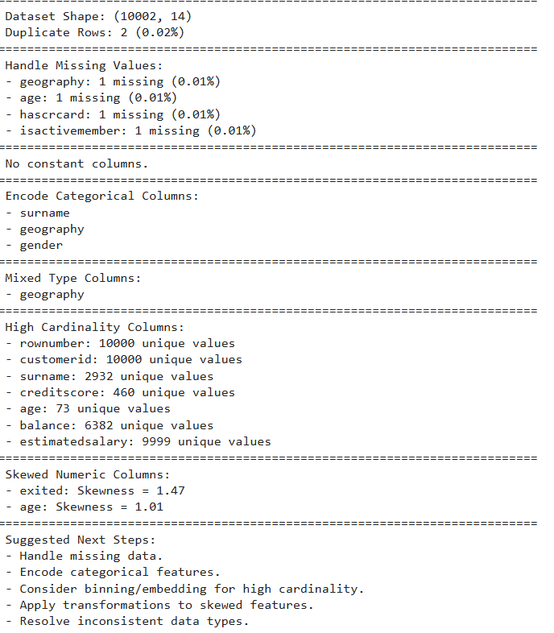
Initial Summary Check

Slide 18
Descriptive Statistics (Numerical Columns)
Metric | rownumber | customerid | creditscore | age | tenure
Count | 10002 | 10002 | 10002 | 10001 | 10002
Mean | 5001.5 | 15,690,930 | 650.56 | 38.92 | 5.01
Std | 2887.47 | 71,931.77 | 96.66 | 10.49 | 2.89
Min | 1 | 15,565,700 | 350 | 18 | 0
25% (Q1) | 2501.25 | 15,628,520 | 584 | 32 | 3
Median (Q2) | 5001.5 | 15,690,730 | 652 | 37 | 5
75% (Q3) | 7501.75 | 15,753,230 | 718 | 44 | 7
Max | 10000 | 15,815,690 | 850 | 92 | 10

Slide 19
Descriptive Statistics (Numerical Columns)
Metric | balance | numofproducts | hascrcard | isactivemember | estimatedsalary
Count | 10002 | 10002 | 10001 | 10001 | 10002
Mean | 76,491.11 | 1.53 | 0.71 | 0.51 | 100,083.33
Std | 62,393.47 | 0.58 | 0.46 | 0.5 | 57,508.12
Min | 0 | 1 | 0 | 0 | 11.58
25% (Q1) | 0 | 1 | 0 | 0 | 50,983.75
Median (Q2) | 97,198.54 | 1 | 1 | 1 | 100,185.24
75% (Q3) | 127,647.84 | 2 | 1 | 1 | 149,383.65
Max | 250,898.09 | 4 | 1 | 1 | 199,992.48

Slide 20
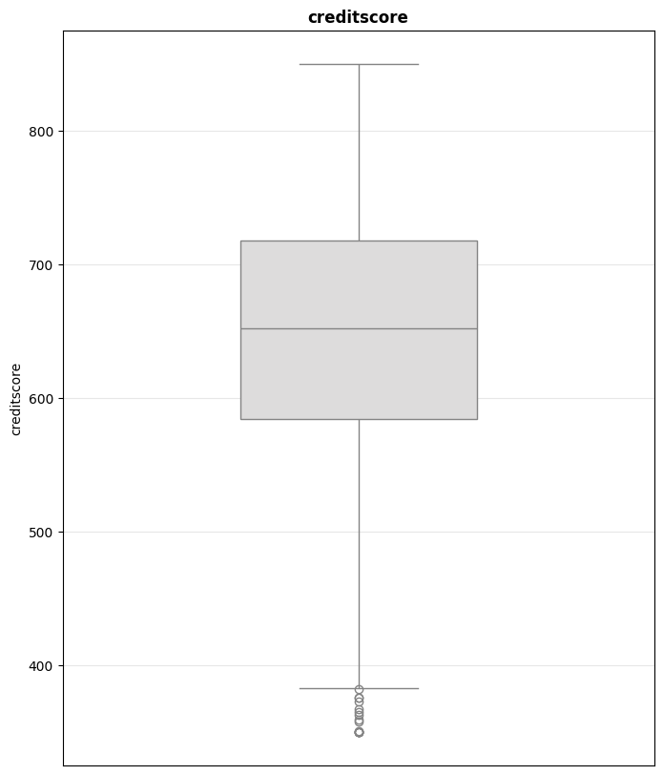
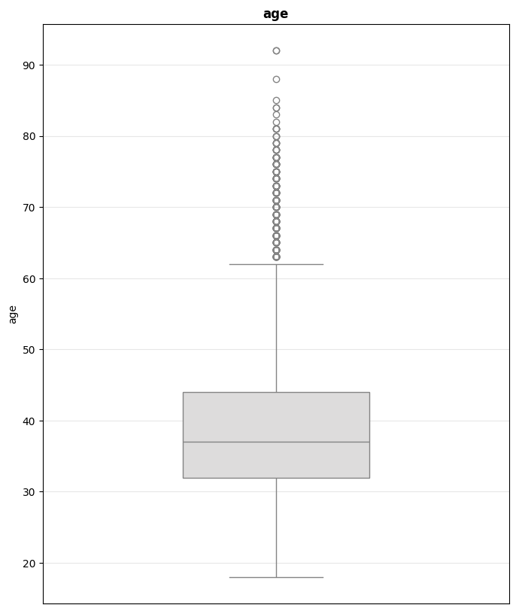
Box Plot
Credit Score
Age

Slide 21
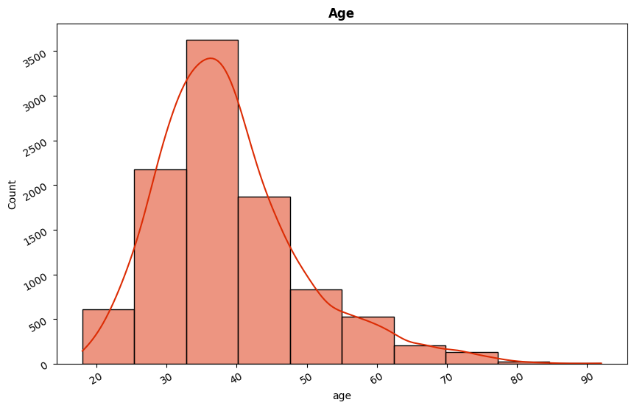
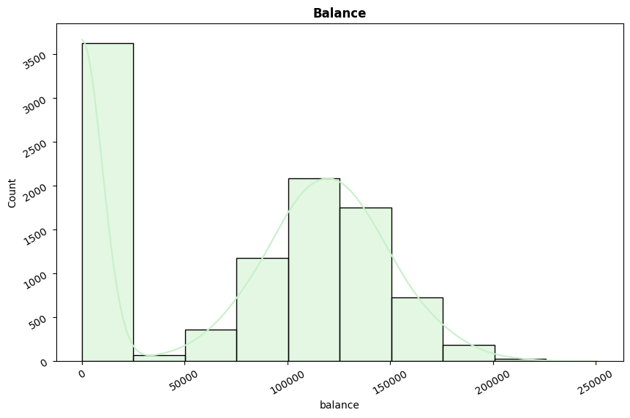
Histogram
Age
Balance

Slide 22
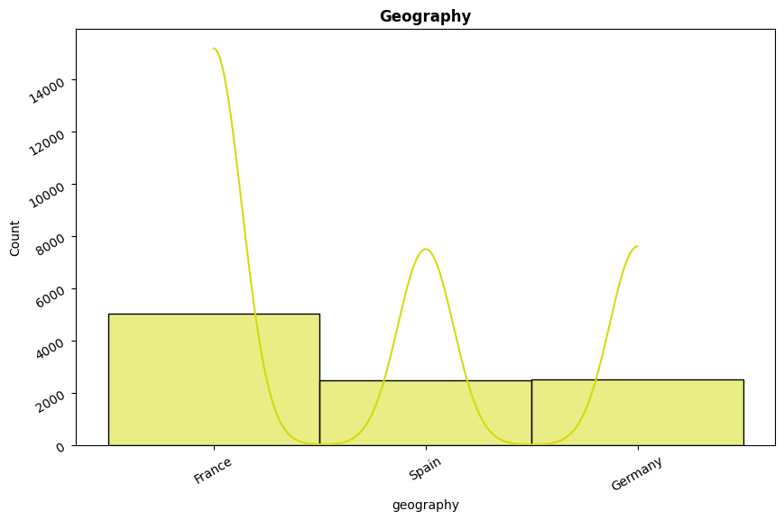
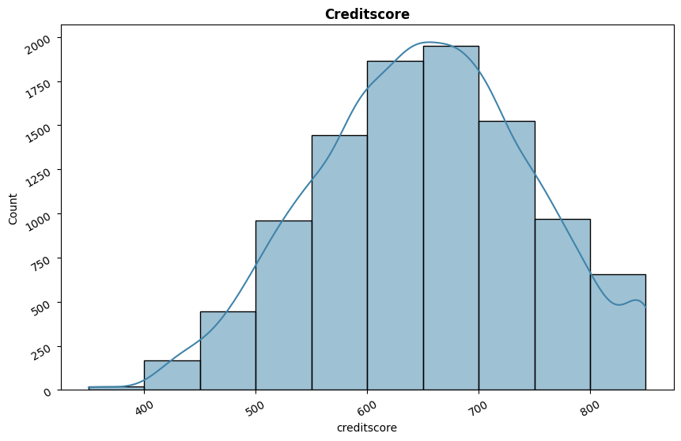
Histogram
Geography
Credit Score

Slide 23
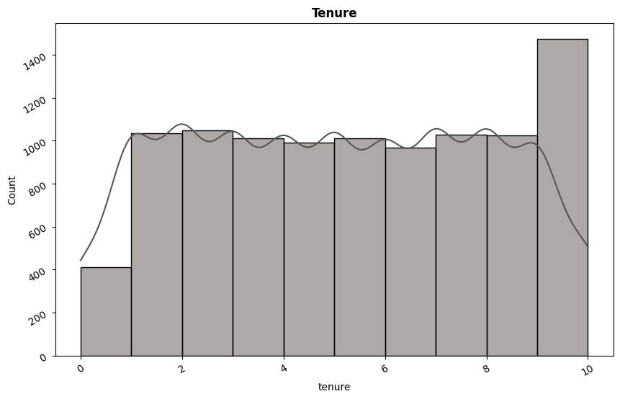
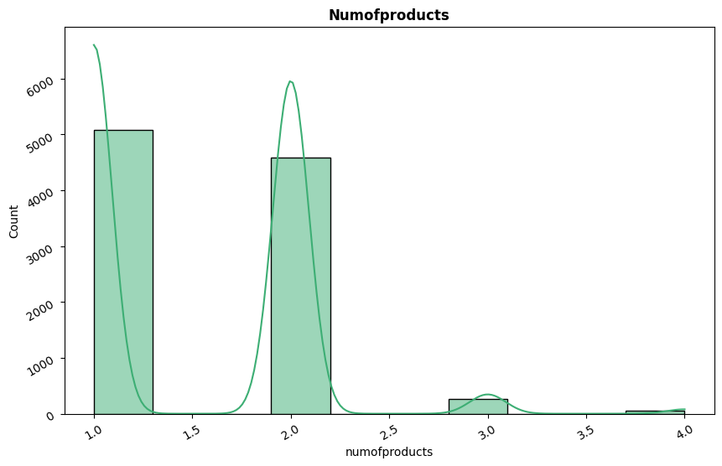
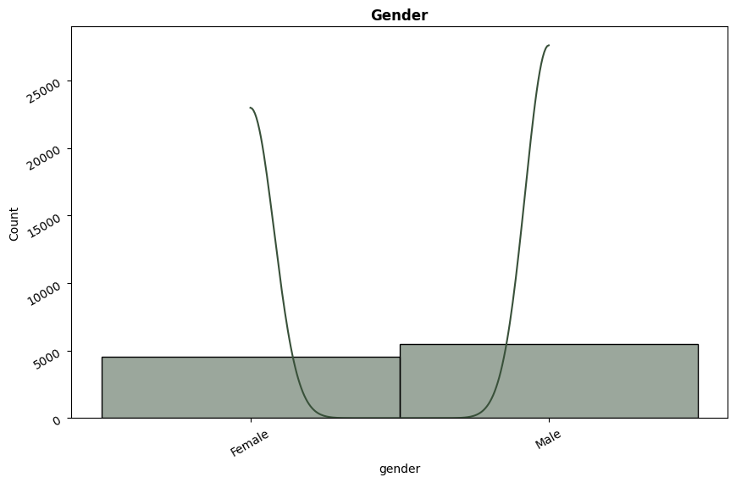
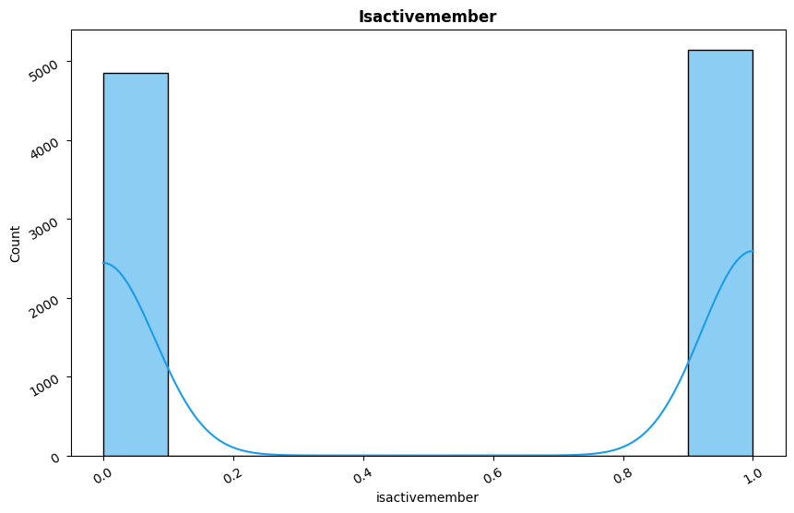
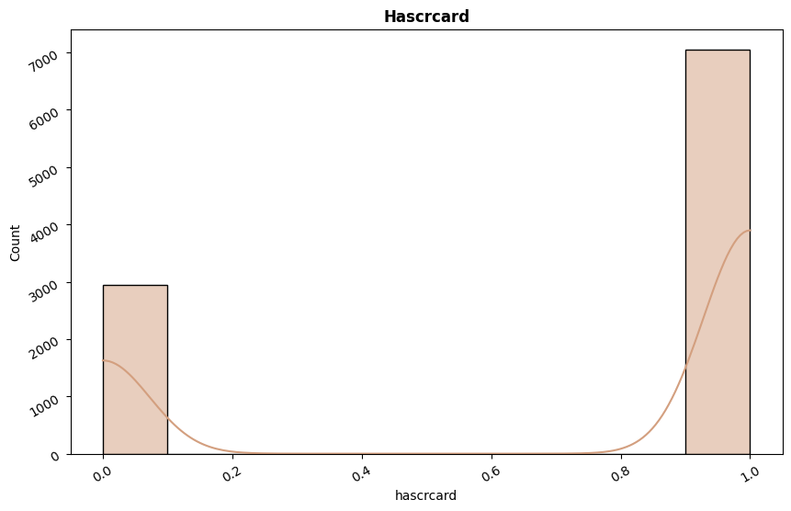
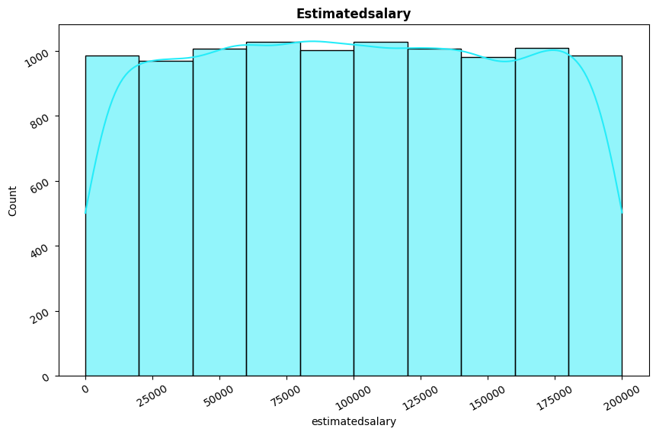

Slide 24
Conclusion
Data Cleaning:
Remove unnecessary columns (rownumber, customerid, surname).
Eliminate duplicate rows.
Handle missing values.
Data Preprocessing:
Apply OneHot encoding for gender and Label encoding for geography.
Handle high cardinality for features like creditscore, balance, and estimatedsalary.
Apply transformations to skewed features like age.

Slide 25
✅ Data Cleaning & ⚙️ Data Preprocessing
No. | Credit Quality | Score Range | Encoded Value
1 | Poor | 300–579 | 0
2 | Fair | 580–669 | 1
3 | Good | 670–739 | 2
4 | Very Good | 740–799 | 3
5 | Excellent | 800–850 | 4
No. | Age Group | Age Range | Encoded Value
1 | Younger | 18–35 | 0
2 | Middle | 35–50 | 1
3 | Older | 50 and above | 2
No. | Salary Group | Salary Range | Encoded Value
1 | Low Salary | 0 < Salary < 40,000 | 0
2 | Middle Salary | 40,000 ≤ Salary < 70,000 | 1
3 | High Salary | Salary ≥ 70,000 | 2
No. | Tenure Group | Tenure Range | Encoded Value
1 | New Client | 0 ≤ Tenure ≤ 1 | 0
2 | Short Client | 1 < Tenure ≤ 3 | 1
3 | Mid Client | 3 < Tenure ≤ 6 | 2
4 | Long Client | Tenure > 6 | 3
No. | Balance Group | Balance Range | Encoded Value
1 | Low Balance | 0 < Balance < 40,000 | 0
2 | Middle Balance | 40,000 ≤ Balance < 120,000 | 1
3 | High Balance | Balance ≥ 120,000 | 2

Slide 26
Unique Values per Feature
Column | Unique Count | Unique Percentage
isactivemember | 2 | 0.020008
geographyspain | 2 | 0.020008
gender | 2 | 0.020008
geographygermany | 2 | 0.020008
geographyfrance | 2 | 0.020008
genderlabel | 2 | 0.020008
exited | 2 | 0.020008
hascrcard | 2 | 0.020008
balancerange | 3 | 0.030012
estimatedsalaryrange | 3 | 0.030012
geography | 3 | 0.030012
tenurerange | 4 | 0.040016
numofproducts | 4 | 0.040016
creditscorerange | 5 | 0.05002
tenure | 11 | 0.110044
age | 73 | 0.730292
ageskewed | 73 | 0.730292
creditscore | 460 | 4.601841
balance | 6379 | 63.815526
estimatedsalary | 9995 | 99.989996

Slide 27
Descriptive Statistics (Numerical Columns)
Metric | creditscore | age | tenure | balance | numofproducts | hascrcard | isactivemember
Count | 9996 | 9996 | 9996 | 9996 | 9996 | 9996 | 9996
Mean | 650.503301 | 38.921071 | 5.013305 | 76476.26322 | 1.530212 | 0.705482 | 0.514906
Std | 96.624668 | 10.488421 | 2.892353 | 62397.11882 | 0.581684 | 0.455849 | 0.499803
Min | 350 | 18 | 0 | 0 | 1 | 0 | 0
25% (Q1) | 584 | 32 | 3 | 0 | 1 | 0 | 0
Median (Q2) | 652 | 37 | 5 | 97173.29 | 1 | 1 | 1
75% (Q3) | 717.25 | 44 | 7.25 | 127639.3725 | 2 | 1 | 1
Max | 850 | 92 | 10 | 250898.09 | 4 | 1 | 1

Slide 28
Descriptive Statistics (Numerical Columns)
Metric | estimatedsalary | exited | genderlabel | geographyfrance | geographygermany | geographyspain | ageskewed
Count | 9996 | 9996 | 9996 | 9996 | 9996 | 9996 | 9996
Mean | 100106.7012 | 0.203782 | 0.545618 | 0.501301 | 0.251 | 0.247699 | 3.65468
Std | 57513.3144 | 0.402829 | 0.49794 | 0.500023 | 0.43361 | 0.431698 | 0.251657
Min | 11.58 | 0 | 0 | 0 | 0 | 0 | 2.944439
25% (Q1) | 51002.11 | 0 | 0 | 0 | 0 | 0 | 3.496508
Median (Q2) | 100238.11 | 0 | 1 | 1 | 0 | 0 | 3.637586
75% (Q3) | 149400.1075 | 0 | 1 | 1 | 1 | 0 | 3.806662
Max | 199992.48 | 1 | 1 | 1 | 1 | 1 | 4.532599

Slide 29
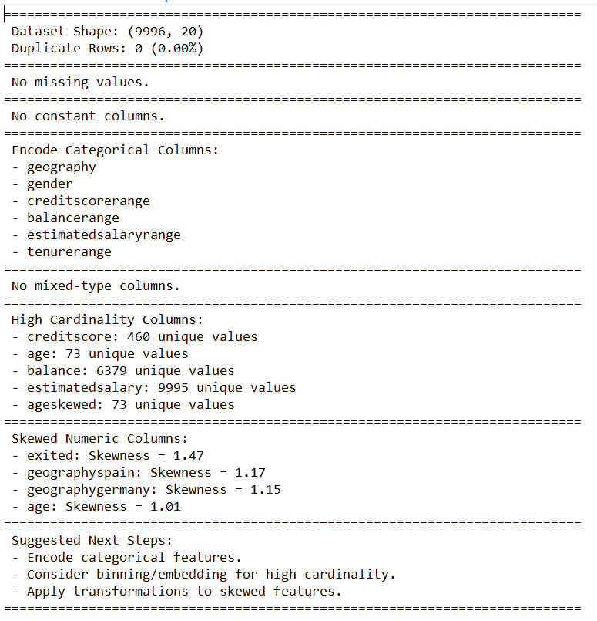
Final Summary Check

Slide 30
Eda
Exploratory Data Analysis

Slide 31
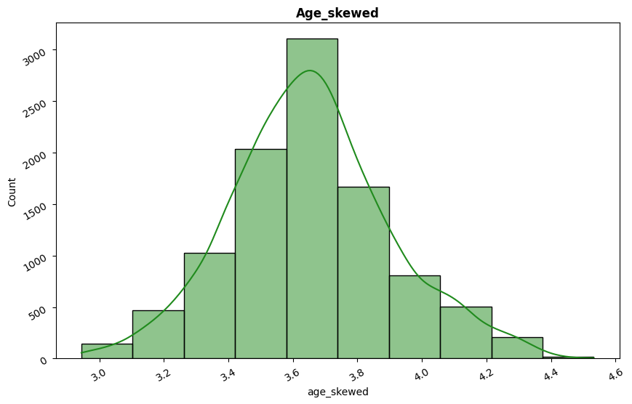
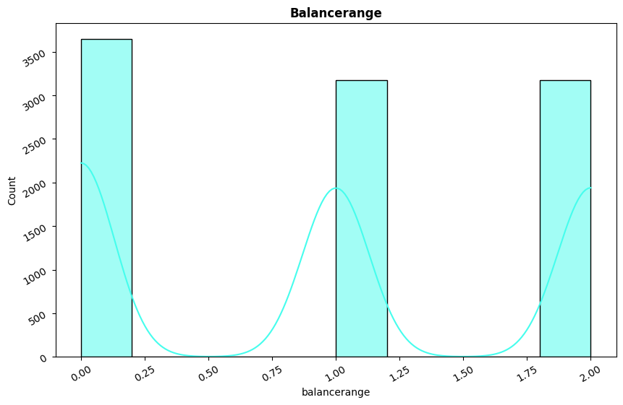
Histograms
Age Skewed
Balance Range

Slide 32
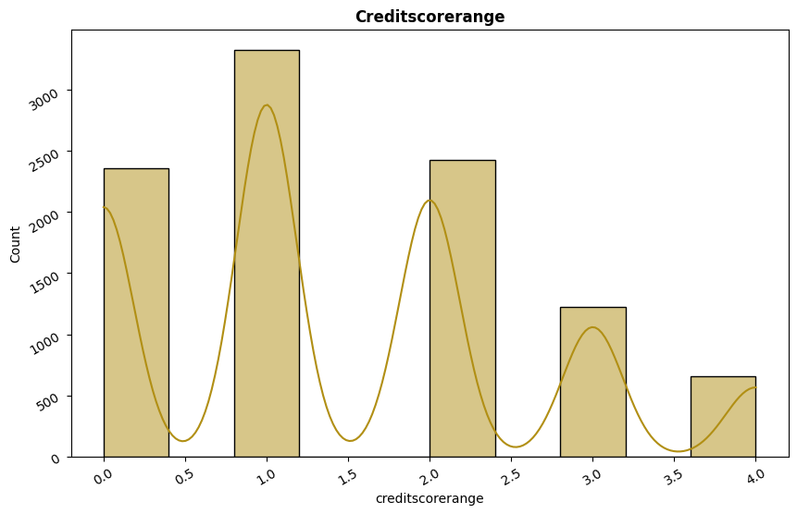
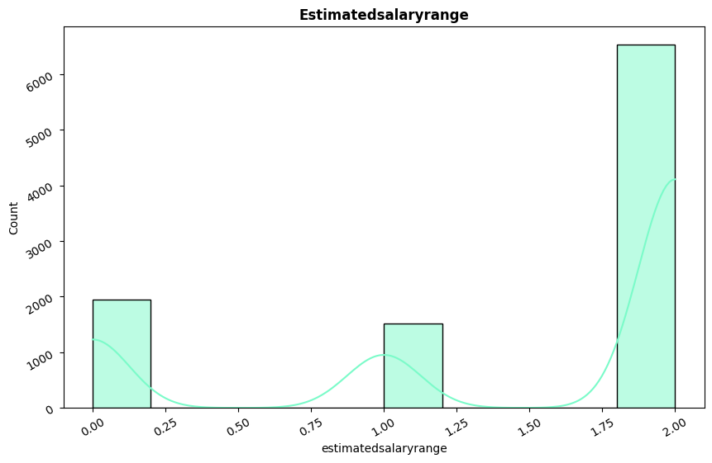
Histograms
Credit Score Range
Estimated Salary Range

Slide 33
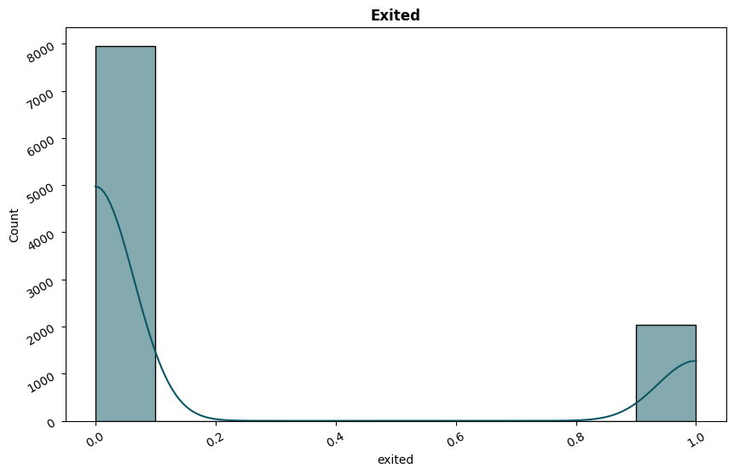
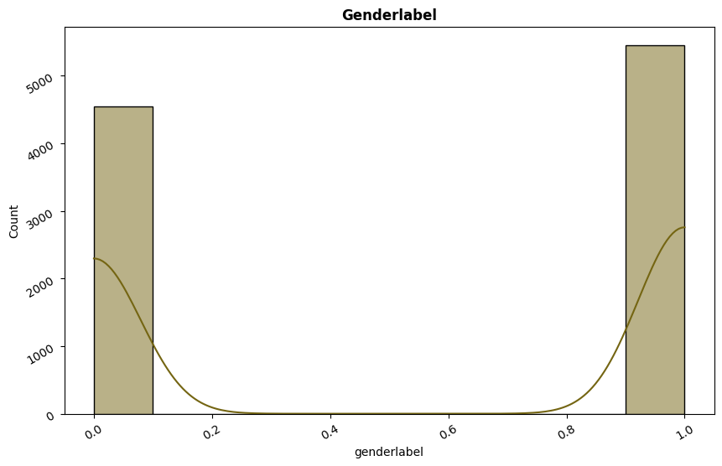
Histograms
Age Skewed
Gender

Slide 34
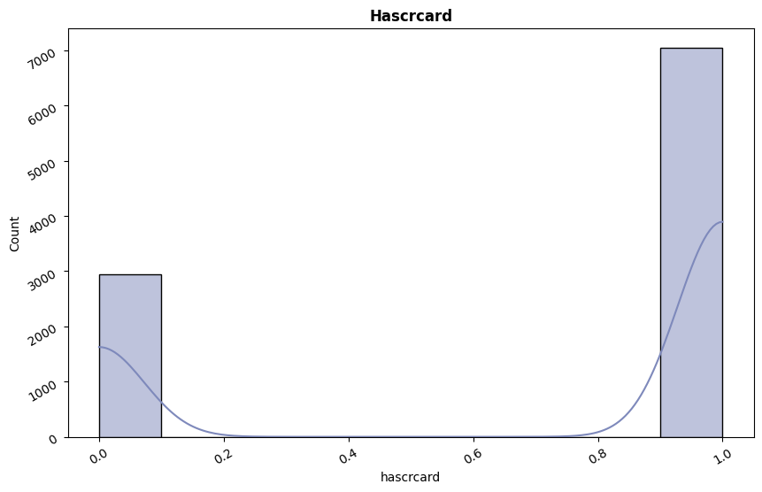
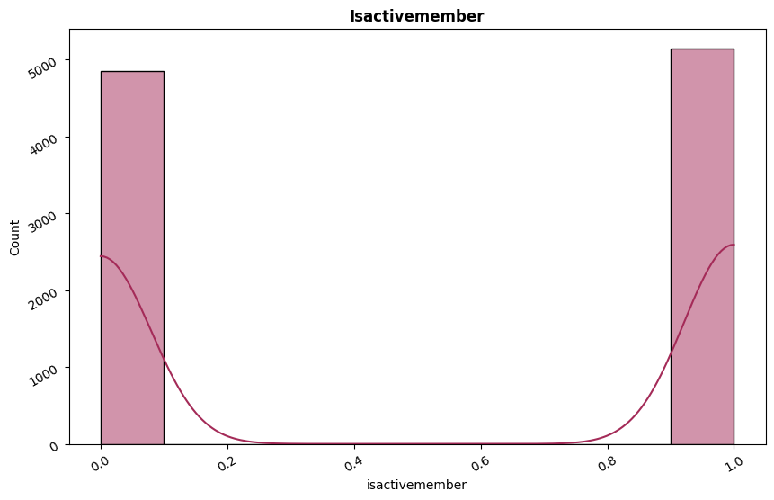
Histograms
Has Credit Card
Active Memeber

Slide 35
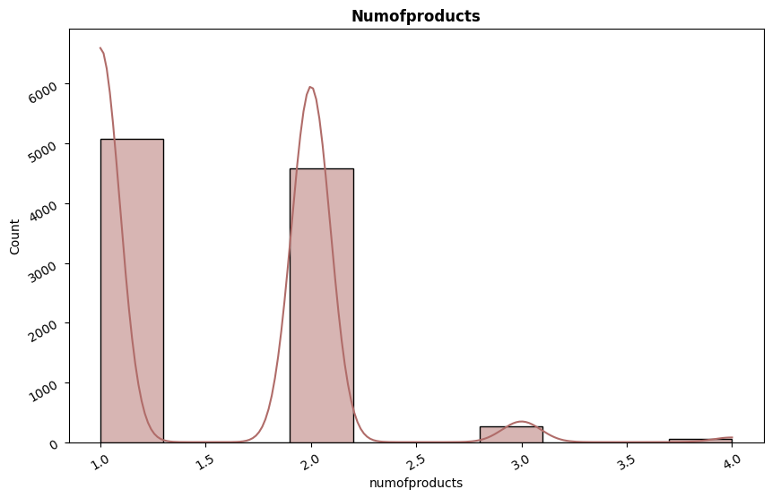
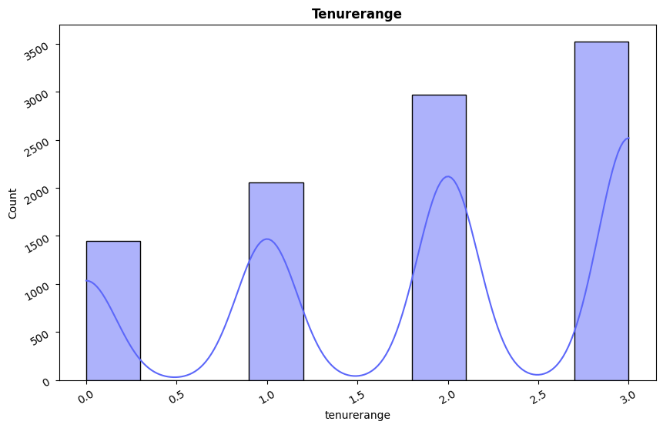
Histograms
Number Of Products
Tenure Range

Slide 36
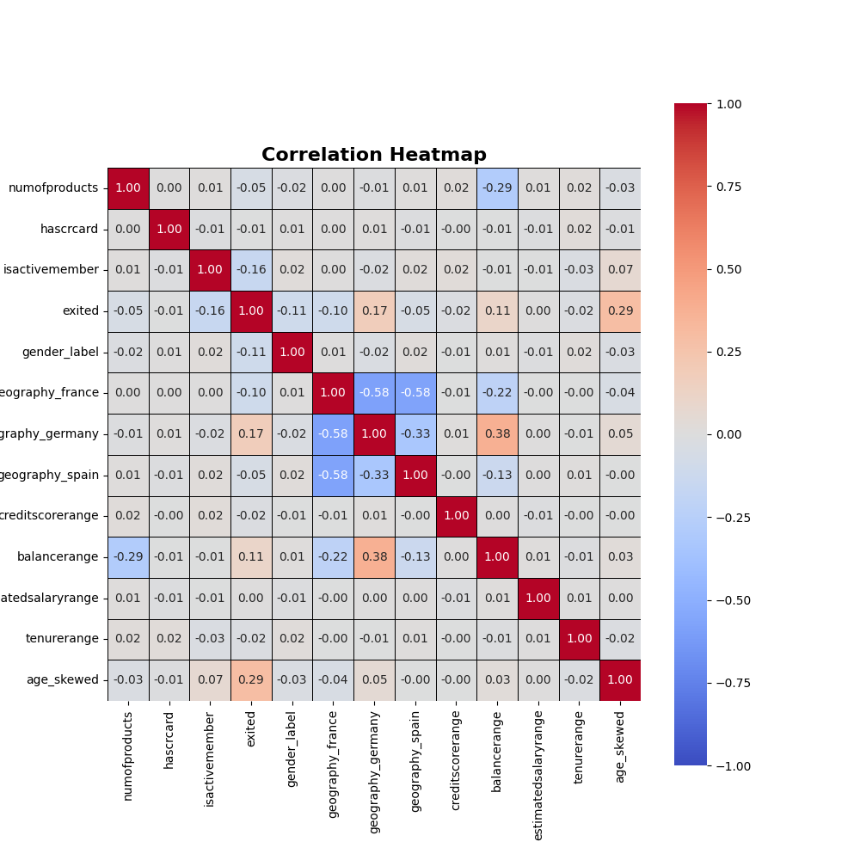
Heat Map
IsActiveMember → moderate negative correlation (0.16): active members are less likely to exit.
AgeSkewed → moderate positive correlation (0.29): older customers are more likely to exit.

Slide 37
Conclusion
Feature Name | Type | Recommendation | Reason for Inclusion/Exclusion
age_skewed | Numerical | ✅ Keep | Older customers show significantly higher churn (corr ≈ 0.29); strong behavioral indicator.
isactivemember | Categorical | ✅ Keep | Active customers are less likely to churn (corr ≈ −0.16); crucial behavioral flag.
geography_germany | Categorical | ✅ Keep | Customers from Germany churn more frequently (corr ≈ 0.17); useful regional feature.
geography_spain | Categorical | ✅ Keep | Contrasts with Germany; adds diversity and comparative signal.
geography_france | Categorical | ❌ Drop | Used as base category to avoid dummy variable trap in one-hot encoding.
balancerange | Numerical | ✅ Keep | Financial indicator; shows bimodal pattern, possibly linked with churn behavior.
creditscorerange | Numerical | 🔹 Optional | Weak or no correlation, but valuable in risk-based financial modeling. Useful for trees.
tenurerange | Numerical | ✅ Keep | Loyalty indicator; bimodal pattern could be informative for churn prediction.
numofproducts | Numerical | ✅ Keep | Discrete but meaningful; customers with more products behave differently. Helps trees.
estimatedsalaryrange | Numerical | 🔹 Optional | Flat distribution; weak predictor, but might support tree models after feature importance check.
gender_label | Categorical | 🔹 Optional | Slight imbalance; very weak churn correlation (−0.10); could be tested but not critical.
hascrcard | Categorical | 🔹 Optional | Almost zero correlation with churn; keep for testing, drop if model doesn’t improve.
exited (target) | Categorical | 🎯 Target | Target variable (imbalanced); apply class balancing methods during training.

Slide 38
Dashboard

Slide 39
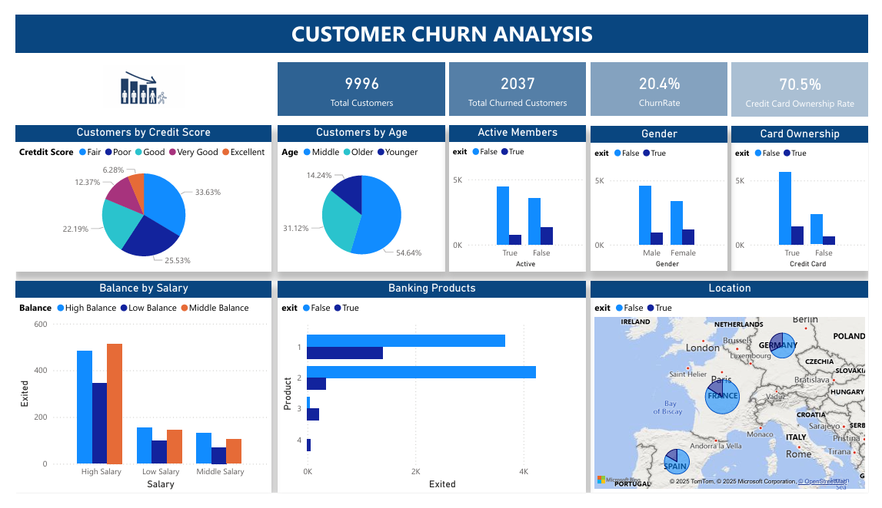

Slide 40
Data Visualization Factors – Power Bi
Geography France, Germany, Spain
Age Younger, Middle, Older
Gender Male, Female
Credit Score Poor, Fair, Good, Very Good, Excellent
Credit Card Ownership Yes, No

Slide 41
Data Visualization Factors – Power Bi
Bank Balance Low, Middle, High
Estimated Salary Low, Middle, High
Banking Products 1 Product, 2 Product, 3 Product, 4 Product
Customer Activity Active, Inactive

Slide 42
Demographics – Power Bi

Slide 43
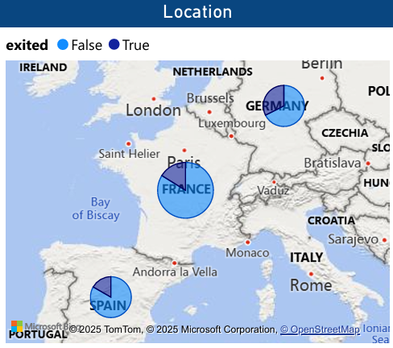
Geography
 | France | Spain | Germany
Total Customers | 5011 | 2476 | 2509
Total Churned Customers | 810 | 413 | 814
Churn Rate Per Total Customers | 16.2% | 16.7% | 32%

Slide 44
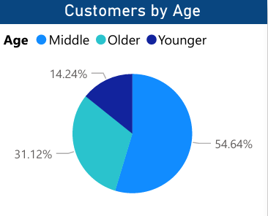
Age
 | Young | Middle | Old
Total Customers | 3678 | 4924 | 1394
Total Churned Customers | 290 | 1113 | 634
Churn Rate Per Total Customers | 7.9% | 22.6% | 45.5%

Slide 45
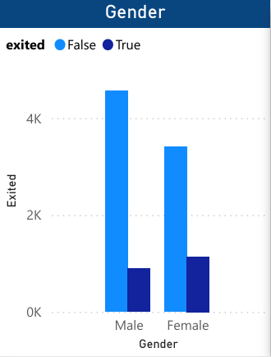
Gender
 | Male | Female
Total Customers | 5454 | 4542
Total Churned Customers | 898 | 1139
Churn Rate Per Total Customers | 16.5% | 25.1%

Slide 46
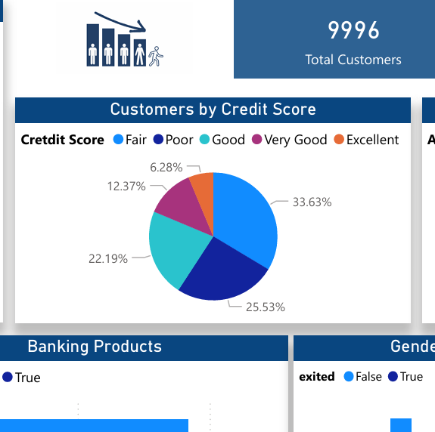
Credit Score
 | Poor | Fair | Good | Very Good | Excellent
Score Range | 300-579 | 580-669 | 670-739 | 740-799 | 800-850
Total Customers | 2361 | 3331 | 2427 | 1224 | 653
Total Churned Customers | 520 | 685 | 452 | 252 | 128
Churn Rate Per Total Customers | 22% | 20.6% | 18.6% | 20.6% | 19.6%

Slide 47
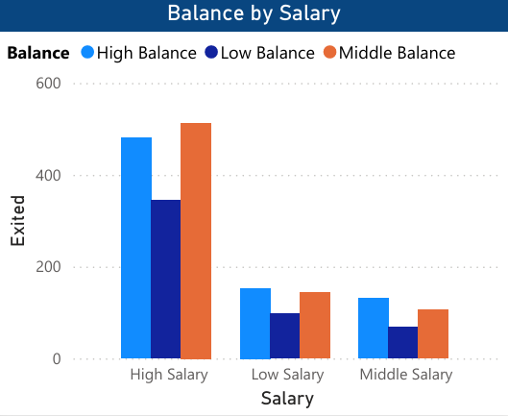
Bank Balance & Estimated Salary
 | Low Salary |  |  | Middle Salary |  |  | High Salary
Balance | Low | Middle | High | Low | Middle | High | Low | Middle | High
Total Customers | 735 | 627 | 592 | 545 | 459 | 509 | 2365 | 2087 | 2077
Total Churned Customers | 98 | 143 | 153 | 69 | 105 | 131 | 344 | 513 | 481
Churn Rate Per Total Customers | 13.3% | 22.8% | 25.8% | 12.7% | 22.9% | 25.7% | 14.5% | 24.6% | 23.2%

Slide 48
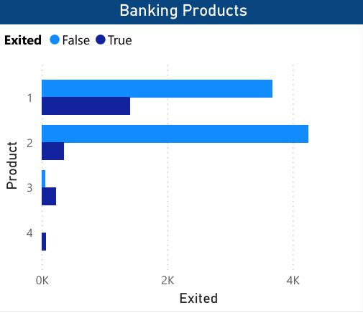
Banking Products
 | 1 | 2 | 3 | 4
Total Customers | 5082 | 4588 | 266 | 60
Total Churned Customers | 1409 | 348 | 220 | 60
Churn Rate Per Total Customers | 27.7% | 7.6% | 82.3% | 100%
Example of Banking Products:
Deposit Products
Loan Products
Credit Products
Investment Products

Slide 49
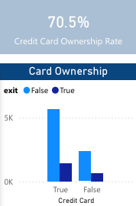
Credit Card Ownership
 | Yes | No
Total Customers | 7052 | 2944
Total Churned Customers | 1424 | 613
Churn Rate Per Total Customers | 20.2% | 20.8%

Slide 50
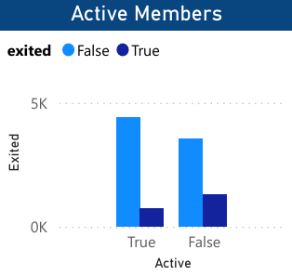
Customer Activity
 | Active | Inactive
Total Customers | 5147 | 4849
Total Churned Customers | 735 | 1302
Churn Rate Per Total Customers | 14.3% | 26.9%

Slide 51
Model Building
Machine learning

Slide 52
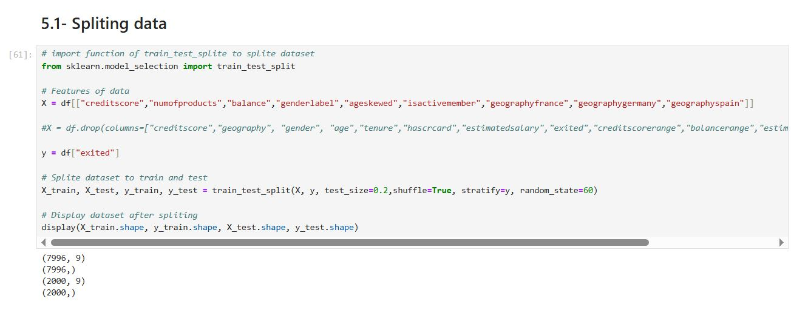
Data Splitting

Slide 53
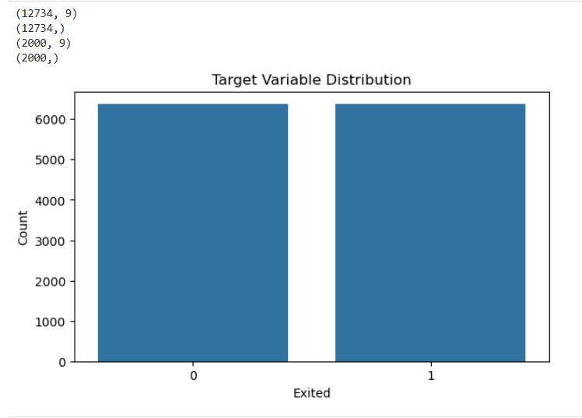
Smote Over sample

Slide 54
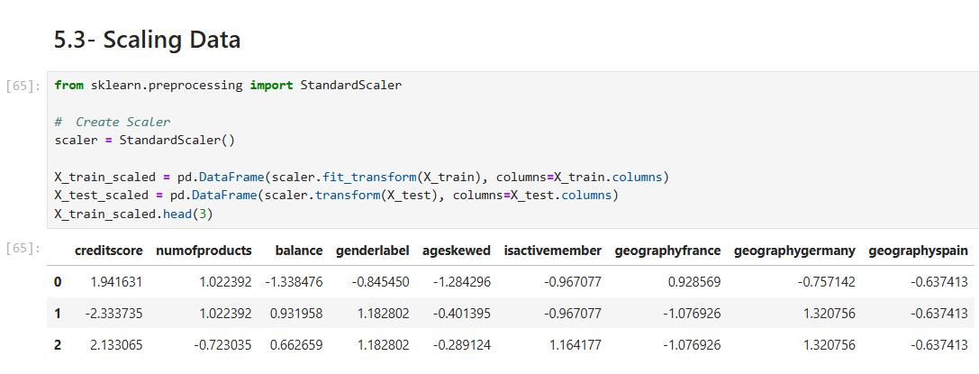
data Scaling

Slide 55
Model Version 1
K-Nearest Neighbors (KNN)
Support Vector Classifier (SVC)
Logistic Regression
Decision Tree
Random Forest
Optimized Random Forest

Slide 56
K-Nearest Neighbors (KNN)
Conclusion:
The model shows signs of overfitting.
Generalization is not ideal.
Performance on unseen data is lower than expected based on training accuracy
Best Hyperparameters:
n_neighbors: 9
weights: Distance
metric: Manhattan
Training Accuracy 99.99%:
Validation Accuracy: 83.80%
Test Accuracy: 83.26%

Slide 57
Support Vector Classifier (SVC)
Conclusion:
The model is overfitting.
High training accuracy but much lower validation/test accuracy.
Needs better regularization or tuning.
Best Hyperparameters:
C: 1
kernel: RBF
gamma: Scale
Training Accuracy: 99.99%
Validation Accuracy: 82.08%
Test Accuracy: 81.71%

Slide 58
Logistic Regression
Conclusion:
Moderate overfitting is present.
Generalization is acceptable, but performance could be improved.
Best Hyperparameters:
C: 0.1
penalty: L1
solver: SAGA
Training Accuracy: 83.16%
Validation Accuracy: 74.30%
Test Accuracy: 73.38%

Slide 59
Decision Tree
Conclusion:
Good generalization capability.
No overfitting — model generalizes well to new data.
Training performance could be slightly improved, but validation/test performance is strong.
Best Hyperparameters:
criterion: Entropy
max_depth: 10
Training Accuracy: 75.66%
Validation Accuracy: 81.53%
Test Accuracy: 81.36%

Slide 60
Random Forest
Conclusion:
Strong generalization with minimal overfitting.
Excellent performance on both validation and test sets.
Best Hyperparameters:
n_estimators: 200
max_depth: 20
Training Accuracy: 94.01%
Validation Accuracy: 85.80%
Test Accuracy: 86.09%

Slide 61
Optimized Random Forest
Conclusion:
Excellent generalization.
Best performing model overall.
Minimal overfitting, strong and stable performance
Best Hyperparameters:
n_estimators: 300
max_depth: 12
Training Accuracy: 90.55%
Validation Accuracy: 85.80%
Test Accuracy: 85.52%

Slide 62
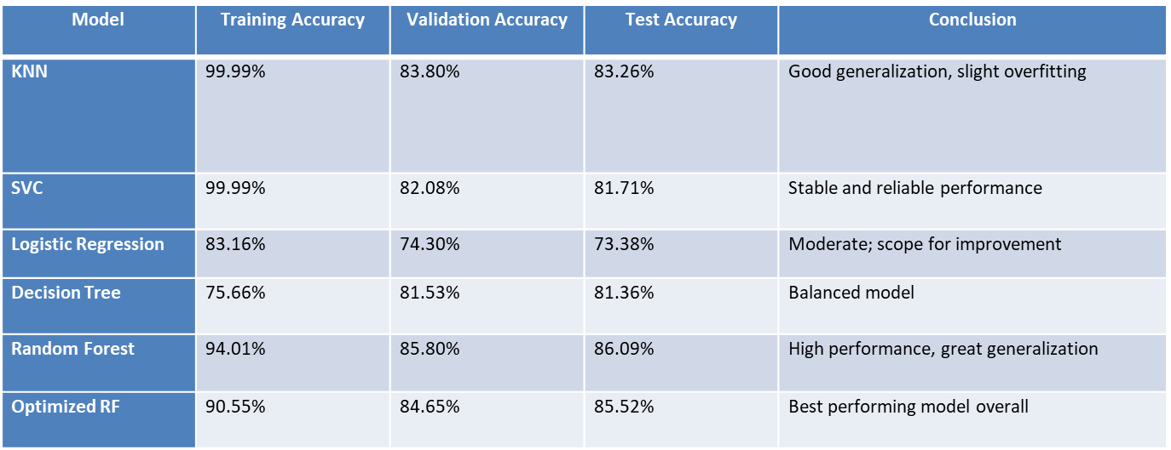
Conclusion - Model Comparison
Optimized Random Forest demonstrated best generalization.

Slide 63
Model Version 2 Before tuning
Logistic Regression
Decision Tree
Random Forest
KNN
SVC
XGBoost

Slide 64
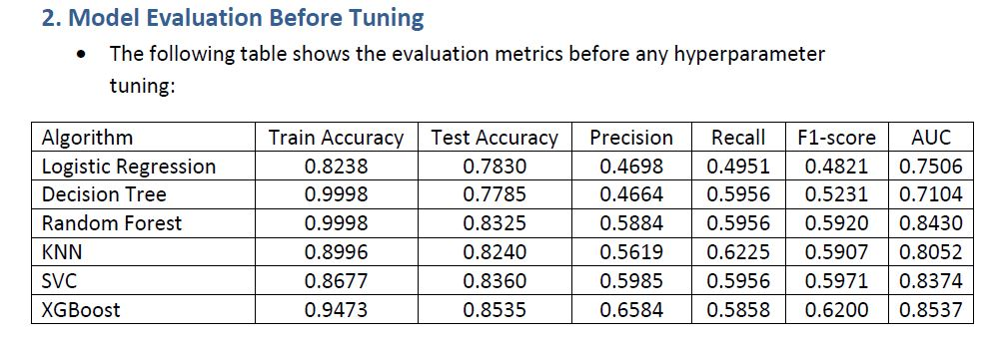
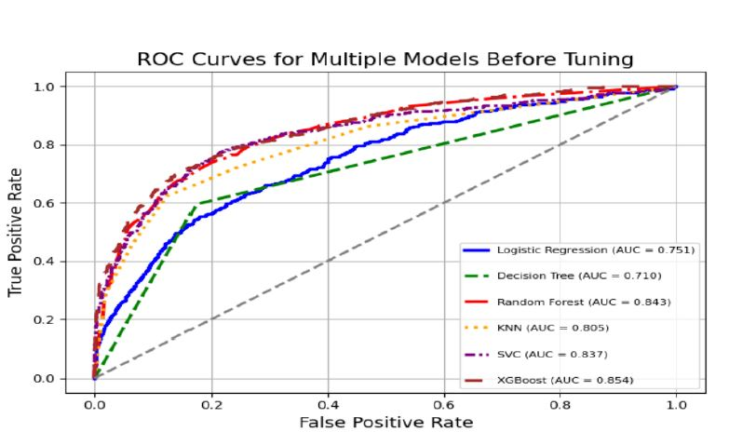
Model Evaluation Before Tuning

Slide 65
Conclusion
Performance Analysis (Before Tuning):
XGBoost achieved the highest Test Accuracy (85.35%) and AUC (0.8537), indicating strong predictive performance.
Decision Tree and Random Forest models showed signs of overfitting due to very high training accuracy.
SVC and XGBoost provided the most balanced results in terms of both Precision and Recall.
And with best AUC xgboost 0.85, random forest 0.84, and SVC 0.83.

Slide 66
Tuning The Best Models
Random Forest
SVC
XGBoost

Slide 67
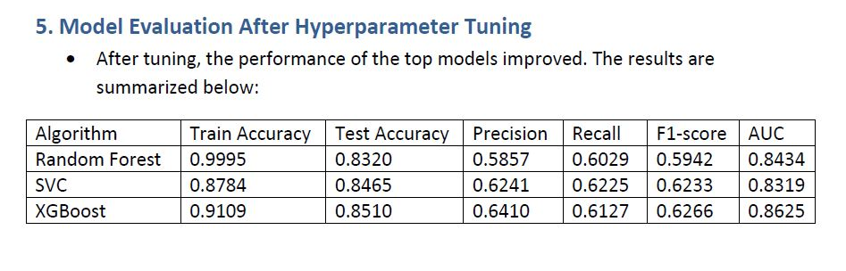
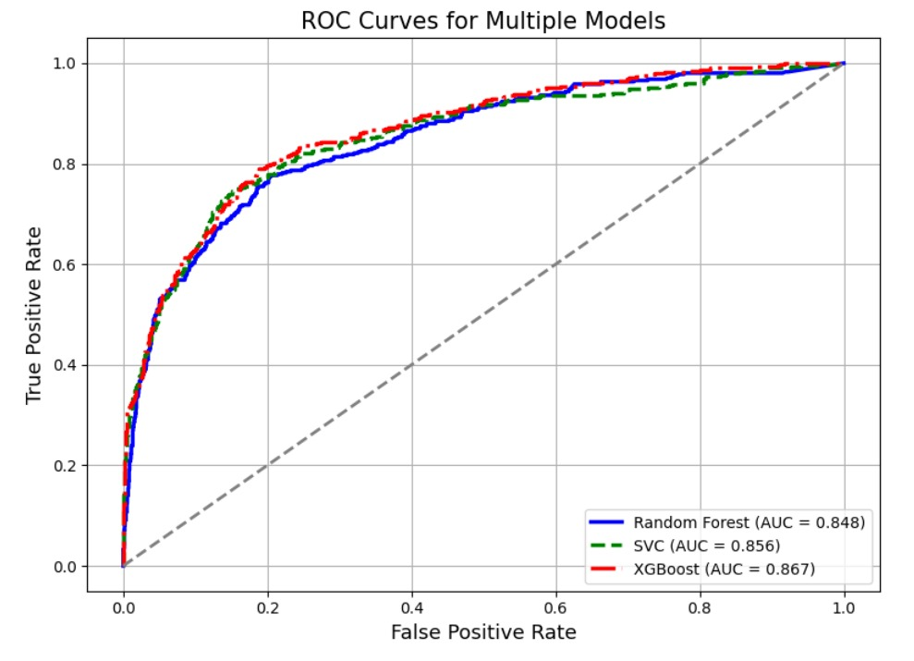
Model Evaluation After Tuning

Slide 68
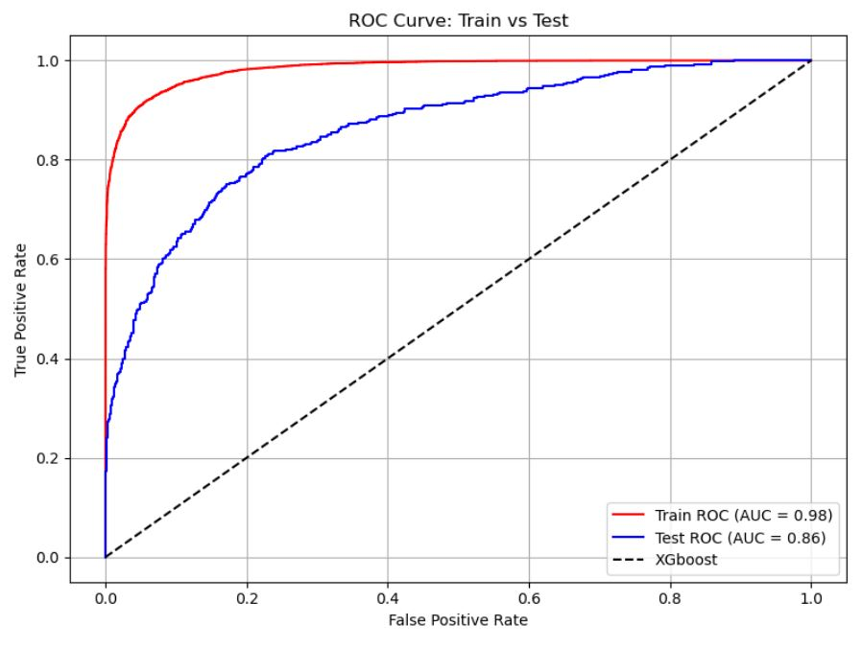

Conclusion
Final Conclusion and Selected Mode:
Based on the evaluation after tuning, XGBoost remains the best-performing model with the highest AUC (0.8625) and a well-balanced Precision and Recall. Hence, it is selected as the final model for deployment.
The best hyperparameters for XGBoost are:-
colsample_bytree = 0.8 - gamma = 0.1 - learning_rate = 0.05 - max_depth = 6 - n_estimators = 300 - scale_pos_weight = 5 - subsample = 0.8 - random_state = 60

Slide 69
Deployment
Model

Slide 70

Saving model weights

Slide 71


Streamlit Api & GUi

Slide 72

Streamlit Cloud real time Requirements

Slide 73


4- REAL TIME Streamlit Cloud & Test Model with real data
And you can visit and use our project through
Link : Bank_Cuatomer_Churn_Prediction

Slide 74
Real Time StreamLit & Model Testing With Real Data
Customer Stay
Customer Exit

Slide 75
Future enhancements/Improvements
Improve data preprocessing by adding and exploring more features.
Collect and prepare data for model training and make it recurring training.
Utilize an ensemble model for better performance.
Add additional functions to enhance AutoML capabilities.

Slide 76
Questions?
THANK YOU

